Slide 1
CUBE & DICES
LEVEL-1

Slide 2
Cube and Dices
Definition and Concept of Cube
Concept of Dice
Types of Dice
Construction of Boxes in Dice
Questions based on open and close dice.

Slide 3
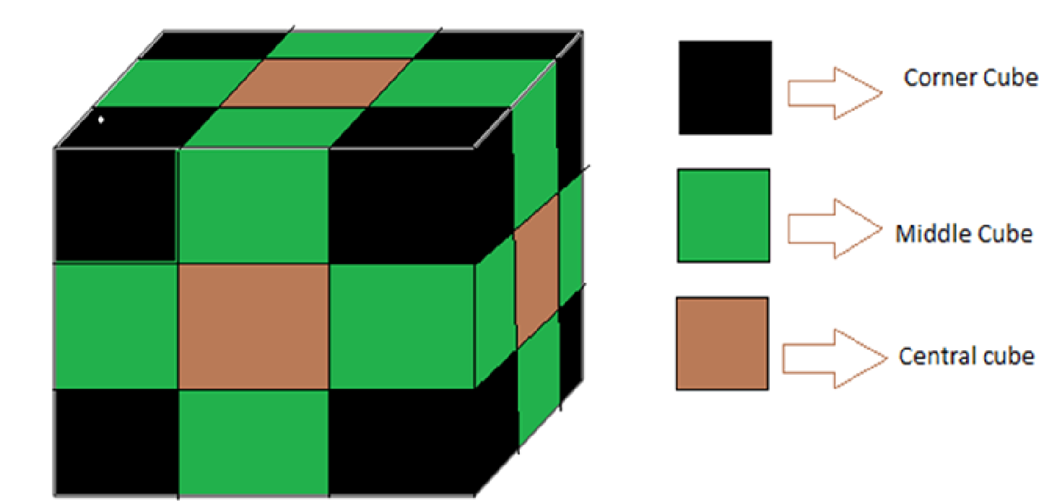
CUBE
A cube is a three dimensional solid having 6 faces, 12 edges, and corners. All edges of a cube are equal and all the faces are square in shape. That is a solid figure which has 6 faces; each face being a square is called a cube.

Slide 4
Concept of Cube
If a cube is painted on all of its surfaces with the same color and then divided into smaller cubes of equal size, then after separation, number of smaller cubes, so obtained will be calculated as under:
Number of smaller cubes with three surface painted = 8
Number of smaller cubes with two surface painted = (n -2 ) x 12
Number of smaller cubes with one surface painted = (n-2)² x 6
Number of smaller cubes with no surface painted = (n -2 )³
Where n = Number of divisions on the surface of the bigger cube

Slide 5
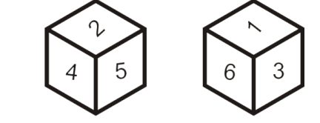

DICE
Dice is a cube having different numbers on all its faces. The numbers are usually a single digit, from 1 to 6.
Also, Die/Dice is a three dimensional figure with each of its six sides/faces showing different numbers/letters/color etc. It has 8 corners and 12 edges. In a dice, length, breadth and height all are equal to each other.

Slide 6
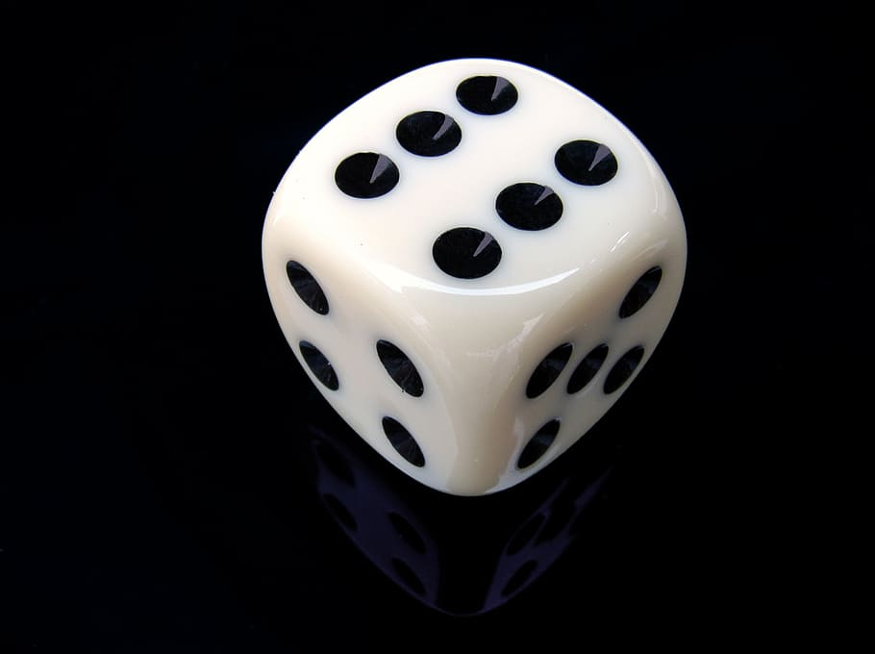

Type of Dice
Let us see the various types of questions that may come one by one from below.
Problem based on Single Dice
In this type of cube and dice reasoning, problems related to single dice will be given.
Problem based on Two or more Dice
In this type of cube and dice reasoning, problems related to two or more that two dice will be given.

Slide 7
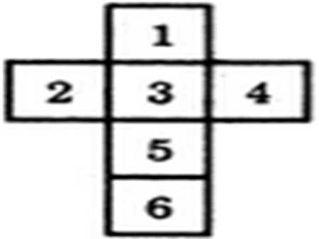
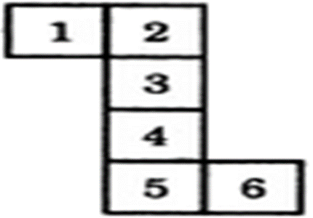
Construction of Boxes in Dice
The details of the cube formed when a sheet is folded to form a box:
Form I
In this case:
1 lies opposite 5,
2 lies opposite 4,
3 lies opposite 6.
Form II
In this case:
1 lies opposite 6,
2 lies opposite 4,
3 lies opposite 5.

Slide 8
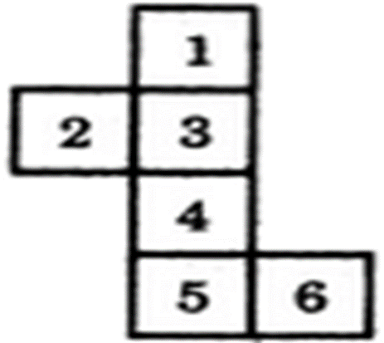
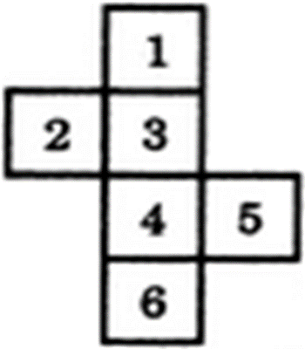
Construction of Boxes in Dice
Form III
In this case:
1 lies opposite 4,
2 lies opposite 6,
3 lies opposite 5.
Form IV
In this case:
1 lies opposite 4,
2 lies opposite 5,
3 lies opposite 6.

Slide 9
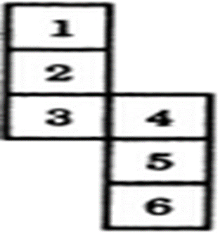
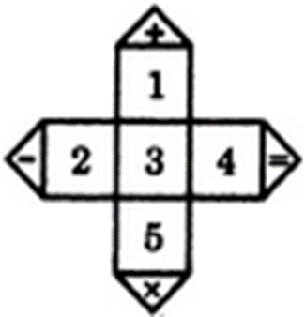
Construction of Boxes in Dice
Form V
In this case:
1 lies opposite 3,
2 lies opposite 5,
4 lies opposite 6.
Form VI
In this case: Signs will be the one of the faces of the cube and it lies opposite 3,
2 lies opposite 4,
1 lies opposite 5.

Slide 10
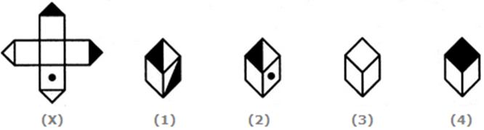
Cube and Dices
1. Choose the box that is similar to the box formed from the given sheet of paper (X).
A. 1 and 2 only B. 2 and 4 only
C. 2 and 3 only D. 1 and 4 only
Notes:
Explanation: Answer: Option C
The fig. (X) is similar to the Form VI. So, when a cube is formed by folding the sheet shown in fig. (X), then is one of the faces of the cube. However, the cube in fig. (1) has two such faces and fig. (4) has a face which is completely shaded. So, these two cubes cannot be formed. Hence, only the cubes in figures (2) and (3) can be formed.

Slide 11
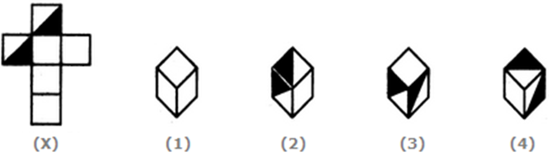
Cube and Dices
2. Choose the box that is similar to the box formed from the given sheet of paper (X).
A. 1 and 4 only B. 3 and 4 only
C. 1 and 2 only D. 2 and 3 only
Notes:
Explanation: Answer: Option A
The fig. (X) is similar to the Form I. So, when the sheet shown in fig. (X) is folded to form a cube then one of the two half-shaded faces lies opposite to one of the blank faces and the other half-shaded face lies opposite to another blank face. The two remaining blank faces lie opposite to each other. Thus, both the cubes shown in figures (1).and (4) can be formed when the sheet shown in fig. (X) is folded. Also, though the cubes shown in figures (2) and (3) have faces that can appear adjacent to each other but the cube formed by folding the sheet in fig. (X) cannot be rotated to form either of the two. Hence, the cubes in figures (2) and (3) cannot be formed.

Slide 12
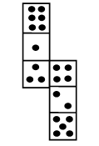
Cube and Dices
3. How many dots lie opposite to the face having three dots, when
the given figure is folded to form a cube?
A. 2 B. 4 C. 5 D. 6
Notes:
Explanation: Answer: Option D
The given figure is similar to Form V. Therefore, when this figure is folded to form a cube then the face bearing six dots will lie opposite the face bearing three dots.

Slide 13
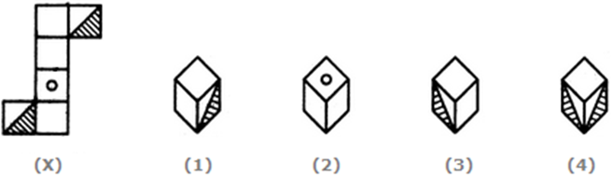
Cube and Dices
4. Choose the box that is similar to the box formed from the given sheet of paper (X).
A. 1 and 3 only B. 1 and 4 only
C. 2 and 4 only D. 3 and 4 only
Notes:
Explanation: Answer: Option A
The fig. (X) is similar to Form II. So, when the sheet shown in fig. (X) is folded to form a cube then the two half-shaded faces lie opposite to each other, the face bearing a circle lies opposite to one of the two blank faces and the two remaining blank faces lie opposite to each other. Therefore, the cubes shown in fig. (4) which has the two half-shaded faces adjacent to each other, cannot be formed by folding the sheet shown in fig. (X). Also, the cube shown in fig. (2) has the face bearing a circle adjacent to two blank faces. This is not possible since there is one blank face opposite to the circle and one blank face opposite to the third blank face. Hence, only the cubes in figures (1) and (3) can be formed.

Slide 14
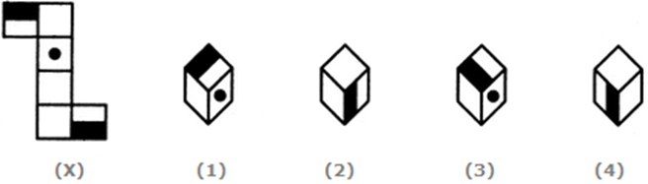
Cube and Dices
5. Choose the box that is similar to the box formed from the given sheet of paper (X).
A. 1 and 2 only B. 2 and 3 only
C. 2 and 4 only D. 1, 2, 3 and 4
Notes:
Explanation: Answer: Option D
The fig. (X) is similar to Form II. So, when a cube is formed by folding the sheet shown in fig. (X), then the two half-shaded faces lie opposite to each other and one. of the three blank faces appears opposite to the face bearing a dot. Clearly, each one of the four cubes shown in figures (1), (2), (3) and (4) can be formed by folding the sheet shown in fig. (X).

Slide 15
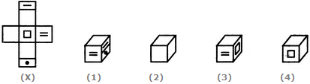
Cube and Dices
6. Choose the box that is similar to the box formed from the given sheet of paper (X).
A. 1 only B. 1 and 3 only
C. 1, 3 and 4 only D. 1, 2, 3 and 4
Notes:
Explanation: Answer: Option C
When the sheet in fig. (X) is folded, then one of the faces of the cube formed will be of the form and this face will lie opposite the face bearing a square. Also, one of the blank faces lies opposite another blank face and the third blank face lies opposite the face bearing an '=' sign. Clearly, all the three blank faces cannot appear adjacent to each other. So, the cube shown in fig. (2) which has all the three blank faces adjacent to each other cannot be formed. Hence, only the cubes shown in figures A, C and D can be formed

Slide 16
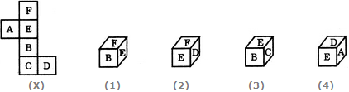
Cube and Dices
7. Choose the box that is similar to the box formed from the given sheet of paper (X).
A. 1 only B. 2 only
C. 1 and 3 only D. 1, 2, 3 and 4 only
Notes:
Explanation: Answer: Option B
The fig. (X) is similar to the Form III. So, when the sheet in fig. (X) is folded to form a cube, then 'F' appears opposite 'B', 'E' appears opposite 'C' and 'A' appears opposite 'D' Therefore, the cube in fig. (1) which shows 'F' adjacent to 'B' the cube in fig. (3) which shows 'E' adjacent to 'C' and the cube in fig. (4) which shows 'A' adjacent to 'D' cannot be formed. Hence, only the cube in fig.(2) can be formed.

Slide 17
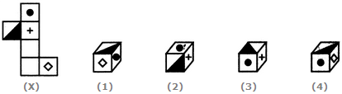
Cube and Dices
8. Choose the box that is similar to the box formed from the given sheet of paper (X).
A. 1 only B. 2 only
C. 3 only D. 4 only
Notes:
Explanation: Answer: Option B
The fig. (X) is similar to the Form III. So, when the sheet in fig. (X) is folded to form a cube, then the half-shaded face appears opposite to the face bearing a rhombus, the face with a black circle appears opposite to one of the two blank faces and the face with a '+' sign appears opposite to the other blank face. Clearly, the cubes shown in figures (1) and (4) cannot be formed since they have the half-shaded face adjacent to the face bearing the rhombus. Also, though the cube shown in fig. (3) has faces that can appear adjacent to each other but the cube formed by folding the sheet in fig. (X) cannot be rotated to form fig. (3). Hence, the cube in fig. (3) cannot be formed. Thus, only the cube shown in fig. (2) can be formed.

Slide 18

Cube and Dices
9. Observe the dots on a dice (one to six dots) in the following figures. How many dots are contained on the face opposite to that containing four dots?
A. 2 B. 3 C. 6 D. Cannot be determined
Notes:
Explanation: Answer: Option A
We shall assume the dice in fig. (ii) to be rotated so that the 5 dots appear at the same position as in fig. (i) i.e. on RHS face (i.e. on face II as per activity 1) and 1 dot appears at the same position as in fig; (i) i.e. on Front face (i.e. on face I). Then, from the, two figures, 2 dots appear on the top face (i.e. on face V) and 4 dots appear on the Bottom face (i.e. on face VI).
Since, these two faces are opposite to each other, therefore, two dots are contained on the face opposite to that containing four dots.

Slide 19

Cube and Dices
10. Three different positions of a dice are shown below. How many dots lie opposite 2 dots?
A.1 B. 3 C. 5 D. 6
Notes:
Explanation: Answer: Option C
From figures (ii) and (iii), we conclude that 1, 6, 3 and 4 dots lie adjacent to 5 dots. Therefore, 2 dots must lie opposite 5 dots. Conversely, 5 dots must lie opposite 2 dots.

Slide 20

Cube and Dices
11. Three positions of a dice are given. Based on them find out which number is found opposite the number 2 in the given cube.
A. 6 B. 5 C. 3 D. 1
Notes:
Explanation: Answer: Option A
From figures (i) and (ii), we conclude that the numbers 1, 4, 3 and 5 lie adjacent to the number 6. Clearly, the number 2 lies opposite 6 and conversely 6 lies opposite 2.

Slide 21

Cube and Dices
12. A dice is thrown four times and its four different positions are shown below. Find the number on the face opposite the face showing 2.
A. 3 B. 4 C. 5 D. 6
Notes:
Explanation: Answer: Option C
From figures (i), (ii) and (iv) We conclude that 6, 4, 3 and 1 lie adjacent to 2. Hence, 5 must lie opposite 2.

Slide 22
Cube and Dices
13. A dice is numbered from 1 to 6 in different ways. If 2 is opposite to 3 and adjacent to 4 and 6, then which of the following statements is necessarily true?
A. 1 is opposite to 5 B. 4 is opposite to 6
C. 4 is adjacent to 2 and 6 D. 1 is adjacent to 2 and 3
Notes:
Explanation: Answer: Option D
If 2 is opposite to 3, then 1 cannot lie opposite to either of the two numbers - 2 or 3. Hence, 1 is necessarily adjacent to both 2 and 3.

Slide 23

Cube and Dices
14. A cube has six different symbols drawn over its six faces. The symbols are dot, circle, triangle, square, cross and arrow. Three different positions of the cube are shown in figures X, Y, and Z. Which symbol is opposite the arrow?
A. Circle B. Triangle C. Dot D. Cross
Notes:
Explanation: Answer: Option B
From figures X and Y, we conclude that dot, circle, square and cross lie adjacent to the triangle. Therefore, the arrow must lie opposite the triangle. From figures X and Z, we conclude that dot, triangle, arrow and cross lie adjacent to the circle. Therefore, the square must lie opposite the circle. Thus, the arrow lies opposite the triangle, the square lies opposite the circle and consequently, the cross lies opposite the dot.
As analysed above, the symbol opposite the arrow is the triangle.

Slide 24

Cube and Dices
15. Given below are three different positions of a dice. Find the number of dots on the face opposite the face bearing 3 dots.
A.4 B.5 C.6 D. Cannot be determined
Notes:
Explanation: Answer: Option C
From figures (i), (ii) and (iii), we conclude that 3, 4, 6 and 1 dots appear adjacent to 2 dots. Therefore, 5 dots appear opposite 2 dots. Now, from figures (i) and (iii), we conclude that 2, 4 and 1 dots appear adjacent to 3 dots. Therefore, either 5 or 6 dots appear opposite 3 dots. Since, 5 dots appear opposite 2 dots, it follows that 6 dots appear opposite 3 dots.

Slide 25
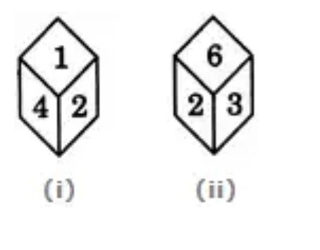
Cube and Dices
16. What will be the number at the bottom, if 5 is at the top; the two positions of the dice being as given below:
A.1 B.2 C.3 D. 6
Notes:
Explanation: Answer: Option B
From figures (i) and (ii), it is clear that 4, 1, 3 and 6 he adjacent to 2. Therefore, 5 must lie opposite 2. Thus, if 5 is at the top, then 2 must be at the bottom.

Slide 26
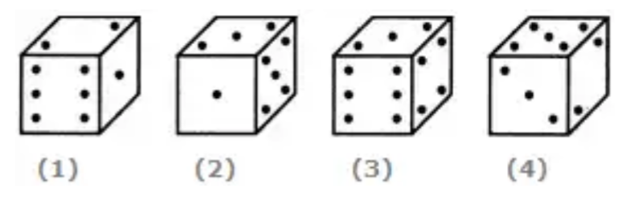
Cube and Dices
17. If the total number of dots on opposite faces of a cubical block is always 7, find the figure which is correct.
A. Fig.1 B. Fig.2
C. Fig.3 D. Fig.4
Notes:
Explanation: Answer: Option B
Since the total number of dots on opposite faces is always 7, therefore, 1 dot appears opposite 6 dots, 2 dots appear opposite 5 dots and 3 dots appear opposite 4 dots.

Slide 27
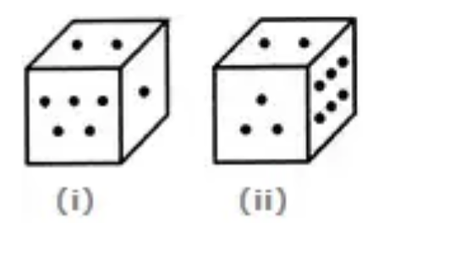
Cube and Dices
18. Two positions of a block are given below. When 1 is at the top, which number will be at the bottom?
A.2 B.3 C.4 D.6
Notes:
Explanation: Answer: Option D
Number 2 is common to the two positions of the dice. We assume the dice in fig. (ii) to be rotated so that 2 remains on the top face (i.e. face V as per activity 1) and the numbers 3 and 6 move to the faces hidden behind 5 and 1 respectively [in fig. (i)]. Then, clearly, 5 lies opposite 3 and 6 lies opposite 1. Hence, when 1 is at the top, then 6 will be at the bottom.

Slide 28
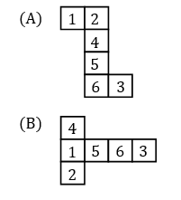
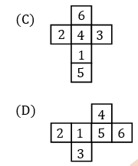
Cube and Dices
19. A standard dice is the one in which the sum of the numbers on the opposite surfaces equals to 7. Which of the below figures, when folded, can create a standard dice?
Notes:
Explanation: Answer- option (D) when folded, can create a standard dice.

Slide 29
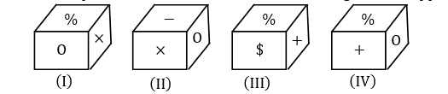
Cube and Dices
20. Four positions of a cube are shown. Which sign will be opposite to ‘+’ ?
A.% B.- C. X D.$
Notes:
Explanation: Answer: Option (C)

Slide 30
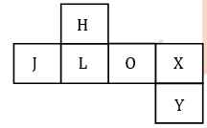

Cube and Dices
21. From the following dice, select the dice that CANNOT be formed when the following figure is folded?
A. Only 3 B. Only 1
C. Only 2 D. Only 2 and 3
Notes:
Explanation: Answer is Option (A)
When the following figure is folded to form a dice, then ‘J’ will be opposite to ‘O’. ‘L’ will be opposite to ‘X’ and ‘H’ will be opposite to ‘Y’. So, by observing all the three dice we can say that dice 3 cannot be formed after folding the given figure as in dice 3 ‘H’ is adjacent to ‘Y’ but ‘H’ should be opposite to ‘Y’.
Hence, option (A) is correct.

Slide 31

Cube and Dices
22. In a dice a, b, c, and d are written on the adjacent faces, in a clockwise order and e and f at the top and bottom. When c is at the top, what will be at the bottom?
A. a B. b C. c D. d
Notes:
Explanation: Answer is option (A)
Clearly, the six faces are labelled as
Face I→ a, Face IV→b, Face III→ c, Face II→d, Face V→e, Face VI→f
Therefore 'a' appears opposite 'c'.
Hence, when 'c' is at the top, then 'a' will be at the bottom.

Slide 32
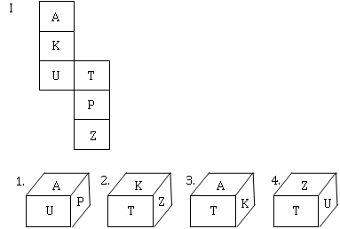
Cube and Dices
23. From the following options, when the following figure is folded to form a dice, which can be the folded dice?
A. Only 2
B. Only 3
C. Only 1 and 3
D. Only 2 and 4
Notes:
Explanation: Answer is option B.
When the following figure is folded to form a dice, then ‘A’ will be opposite to ‘U’ but cannot be adjacent to ‘U’, Therefore, option A will be eliminated. ‘T’ will be opposite to ‘Z’ and ‘K’ will be opposite to ‘P’. So, by observing all the four dices we can say that dice 3 will be formed after folding the given figure.
Hence, option (B) is correct.

Slide 33
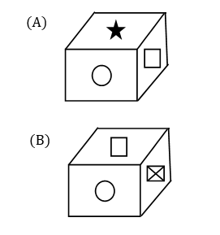
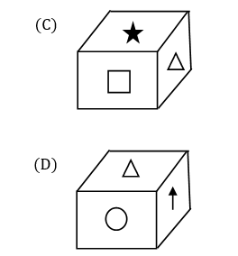
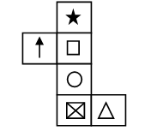
Cube and Dices
24. Which of the following cubes can be formed when the given figure is folded to form a cube?
Notes:
Explanation: Answer is Option C
Opposite elements can’t be placed adjacent to each other.
Hence, option (C) is correct.

Slide 34
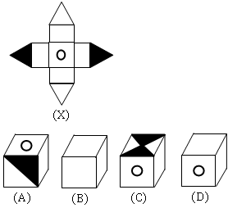
Cube and Dices
25. Choose the box that is similar to the box formed from the given sheet of paper (X).
(A)
(B)
(C)
(D)
Notes:
Explanation: Answer is Option D.
Explanation: Clearly in this design, if we consider the dotted side to be the bottom, the four blank square sides will make the lateral sides of the cube. And the four triangles will fold in to make the top square such that the two shaded triangles meet at their tips from opposite sides. Since the dotted side and the side with triangles must be opposite to each other, we can eliminate options A and C. Now the figure can also be eliminated, as well as the three blank surfaces cannot be adjacent to each other.
Hence, option (D) is correct.

Slide 35
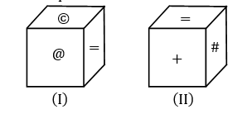
Cube and Dices
26. Two positions of a cube are shown below. What will come opposite to face containing @ ?
+
=
#
@
Notes:
Explanation: Answer is option C
As in cube I and II, as ‘=’ is the only common element in different surfaces then we can apply clockwise rotation from ‘=’.
Now, @ is opposite to #
+ is opposite to ©.
Hence, Option (C) is correct.

Slide 36
27. A bigger cube is painted yellow on each of its faces. Now the cube is cut into 2744 identical pieces making minimum number of cuts. how many of the smaller cubes will have exactly two faces painted?
A. 144
B. 49
C. 58
D. 68
Cube and Dices
Notes:
ANS-A

Slide 37
Cube and Dices
28. A cube of each side 17 cm, has been painted black, red and green on pairs of opposite faces. It is then cut into small cubes of each side 1 cm. Find the No. of small cubes having no face painted ?
A. 3333
B. 3375
C. 3354
D. 3575
Notes:
ANS-B

Slide 38
Cube and Dices
29. A solid cube of each side 12 cms, has been painted red, blue and black on pairs of opposite faces. It is then cut into cubical blocks of each side 3 cms.
How many cubes have two faces painted red and black and all other faces unpainted?
8
4
32
16
Notes:
ANS-A

Slide 39
Cube and Dices
30. A bigger cube is painted yellow on each of its faces. Now the cube is cut into 2744 identical pieces making minimum number of cuts. how many of the smaller cubes will have exactly one face painted?
A. 864
B. 144
C. 8
D. 1728
Notes:
ANS-A

Slide 40
Cube and Dices
Directions (31-35). A bigger cube of size 16×16×16 cm. is coloured in two
opposite pair of surfaces by black, two opposite pair of surfaces by red and
remaining two opposite pair of surfaces by blue colour respectively?
Finally it divide small cubes of 4cm side?
Q 31. Number of small cubes which must have mandatory all three surfaces have different coloured?
(a) 6 (b) 8 (c) 27 (d) 9
Notes:
ANS-B

Slide 41
Cube and Dices
Directions (31-35). A bigger cube of size 16×16×16 cm. is coloured in two opposite pair of surfaces by black, two opposite pair of surfaces by red and remaining two opposite pair of surfaces by blue colour respectively? Finally it divide small cubes of 4cm side?
Q 32. Number of small cubes which have two surface coloured with black and red?
(a) 36 (b) 8 (c) 27 (d) 24
Notes:
ANS-B

Slide 42
Cube and Dices
Directions (31-35). A bigger cube of size 16×16×16 cm. is coloured in two opposite pair of surfaces by black, two opposite pair of surfaces by red and remaining two opposite pair of surfaces by blue colour respectively? Finally it divide small cubes of 4cm side?
Q 33. Number of small cubes which are coloured two faces atleast blue and red?
(a) 27 (b) 16 (c) 12 (d) 1
Notes:
ANS-B

Slide 43
Cube and Dices
Directions (31-35). A bigger cube of size 16×16×16 cm. is coloured in two opposite pair of surfaces by black, two opposite pair of surfaces by red and remaining two opposite pair of surfaces by blue colour respectively? Finally it divide small cubes of 4cm side?
Q 34. Number of small cubes which are coloured with only blue?
(a) 20 (b) 8 (c) 2 (d) 6
Notes:
ANS-B

Slide 44
Cube and Dices
Directions (31-35). A bigger cube of size 16×16×16 cm. is coloured in two opposite pair of surfaces by black, two opposite pair of surfaces by red and remaining two opposite pair of surfaces by blue colour respectively? Finally it divide small cubes of 4cm side?
Q 35. Total number of small cubes which have atleast one surface red?
(a) 32 (b) 18 (c) 27 (d) 26
Notes:
ANS-A

Slide 45
Any Doubts???

